Slide 1


ML-Modeler: A Web Application for Automated Analysis on Cyber Attacks
Bachelor’s Thesis
University of Cyprus
Department of Computer Science
Supervisor
George Pallis
May 2023
Andreas Demosthenous

Slide 2
Presentation Structure
OVERVIEW
motivation
CONTRIBUTIONS
BACKGROUND
EXPERIMENTAL ANALYSIS
CONCLUSIONS
System description
LIVE PRESENTATION
questions

Slide 3
1. OVERVIEW
Implementation of a web application that automates data analysis operations
Experimental analysis of 2 cyber-attack datasets and evaluation of several algorithms used in data analytics

Slide 4

2. MOTIVATION
Cyber attacks: One of the most damaging threats to organizations
DDoS attacks, Brute Force attacks, Port scans => Low complexity, easy to perform
Challenges in analyzing and detecting these attacks
Not enough publicly available data for analysis
Sophisticated attacks => hard to distinguish from legitimate traffic
Lack of tools available for automating the analysis from a research perspective
Most enterprise tools focus on deploying accurate models
Not research oriented

Slide 5

3. CONTRIBUTIONS
Implementation of a scalable, user friendly and easy to use tool that automates several data-analytics’ operations. A tool that can be extended to support more operations and provide more insights to the user.
Results & Conclusions of an experimental analysis on 2 publicly available datasets (CIC-DDoS2019, CIC-IDS2017)
Comparison between 2 feature Correlation algorithms (Pearson & Spearman)
Comparison between 2 K-Best feature selection algorithms (Mutual Info. vs ANOVA)
Comparison between 5 machine learning algorithms (DTC vs RFC vs XGBC vs KNN vs LDA)
Evaluation of the network traffic features regarding cyber-attack detection
Evaluation of the 5 machine learning algorithms under different settings

Slide 6
4. BACKGROUND

Slide 7

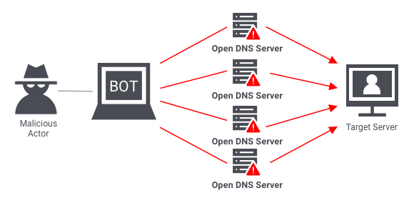
DDoS (Distributed Denial of Service) attacks
Reflective DDoS: Attacker uses public services to redirect (reflect) useless traffic to the target (e.g., DNS amplification)
Exploitation DDoS: Attacker uses vulnerabilities in protocols or technologies to cause the target to crash (e.g., UDP Flood)
DDoS Tools
GoldenEye
Hulk
SlowHTTPTest

Slide 8
Other attacks
Brute Force attacks
Port Scans

Slide 9
Data Analysis on network traffic datasets
Data cleaning
Feature Selection
Constant Features
Correlated Features
Best Features
Model Training
Model Tuning

Slide 10
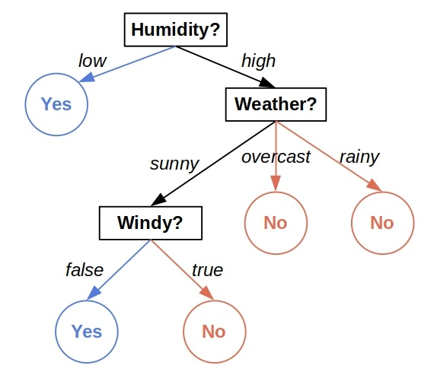
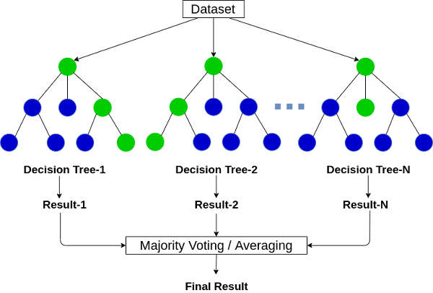
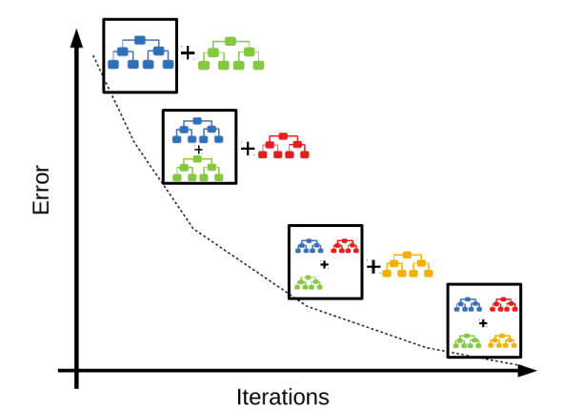
Cyber-Attack detection with traffic analysis and Machine Learning
Tree-Based algorithms
Decision Trees
Random Forest
Extreme Gradient Boost
RF
XGB
DT

Slide 11
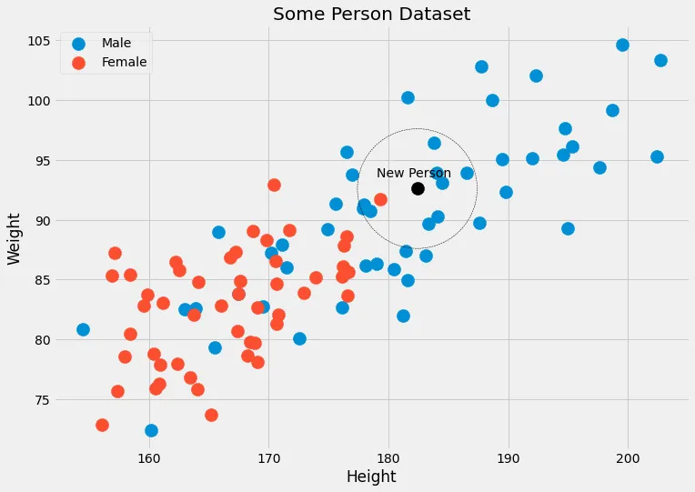
K-Nearest Neighbors
Given a data point x (New Person), what is the probability of x belonging to some class c (Male or Female)?
KNN tries to approximate the probability not with data points that have exactly the features x (because they might not exist), but with data points with features close to x (Euclidian distance).
We can see that the closest data points to the New Person are 4 male labels and one female label. So, KNN will output that the person belonging to the black point is 4/5=80% male and 1/5=20% female.

Slide 12
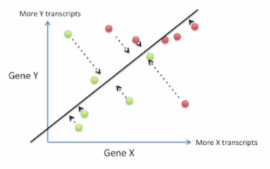
Linear Discriminant Analysis
Dimensionality Reduction => Higher training speed
Ideal for Supervised multi-classification problems
The aim of LDA is:
Transform the given sample space in a reduced version where the different target classes are as separated as possible and their sample are as close together as possible.
=> higher prediction confidence and
less misclassifications

Slide 13
Feature Selection
Correlation Algorithms:
Pearson
Measures the linear relationship between
two continuous variables
Spearman
Can capture non-linear relationships as well

Slide 14
Feature Selection
K-Best Feature Selection Algorithms:
ANOVA
Captures the linear dependencies of the
features with the target variable to identify
the most influential features
Mutual Information Tests
Captures any kind of dependency between the
features and the target variable to identify
the most influential features.

Slide 15
5. Experimental Analysis

Slide 16
Python (v. 3)
Sklearn: Algorithms
NumPy, Pandas: Data structures
PyMongo: Database interaction
Psutil: Process handling

Slide 17

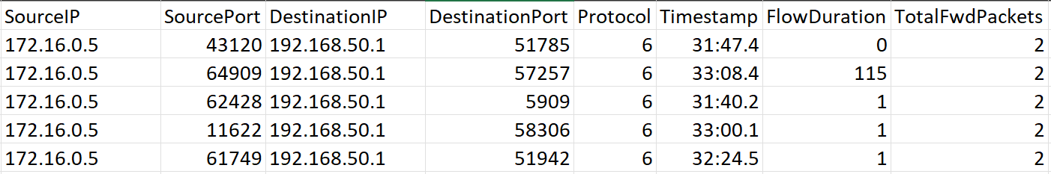
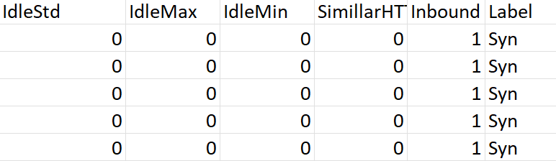
Datasets
Canadian Institute of Technology
Cyber attacks simulation in a controlled environment
Dataset extraction with CIC-FlowMeter tool ( 87 features )
CIC-DDoS2019
NetBIOS DDoS, UDP-Lag DDoS, Syn DDoS, NTP DDoS, SNMP DDoS, SSDP DDoS, LDAP DDoS, MSSQL DDoS, UDP Flood DDoS, DNS DDoS
CIC-IDS2017
DDoS, DoS GoldenEye, DoS Hulk, DoS SlowHttpTest, Dos Slowloris, FTP-Patator, SSH-Patator, Port Scan

Slide 18
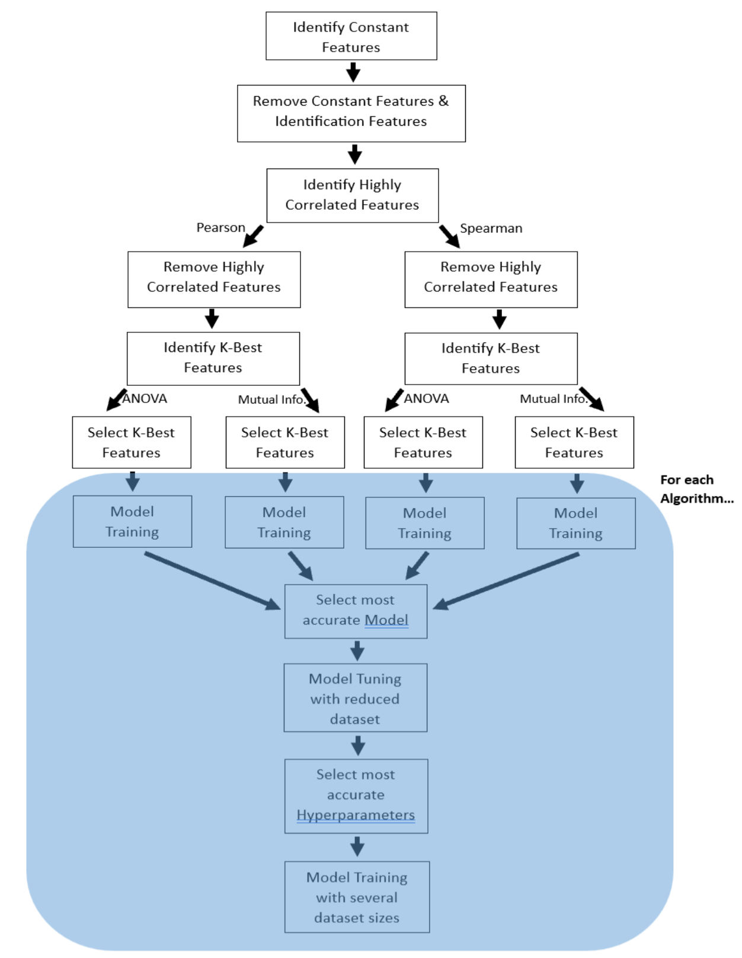
Methodology
Converted negative values to 0
Excluded samples with at least one NULL feature
Encoded string features to numerical
CIC-DDoS2019: 100,000 samples/class
CIC-IDS2017: 10,000 sample/class

Slide 19
Identification Features
FlowID
Source IP
Destination IP
Source Port
Destination Port
Timestamp

Slide 20
Highly Correlated Features
Pearson & Spearman
95% correlation
Algorithm | CIC-DDoS2019 | CIC-IDS2017
Pearson | 26 Correlations | 22 Correlations
Spearman | 39 Correlations | 30 Correlations

Slide 21
K-Best Features
ANOVA & Mutual Information Tests
{best-5, best-10, best-15, …, best-50}
+1 point for each feature, for every appearance in any of the best-k subsets

Slide 22
Fwd Packet Length Max
Flow Bytes/s
Act_data_pkt_fwd
Protocol
CIC-DDoS2019, K-Best Features Histogram

Slide 23
Flow Duration
Max Packet Length
Flow IAT Std
Total Fwd Packets
CIC-DDoS2017, K-Best Features Histogram

Slide 24
Machine Learning
Decision tree classifier
Random forest classifier
Extreme gradient boost classifier
K-nearest neighbors
Linear discriminant analysis
Default hyperparameters
10-Fold cross validation
Feature normalization at [0, 1] scale
CIC-DDOS2019: 100,000 samples/class
CIC-IDS2017: 10,000 samples/class

Slide 25
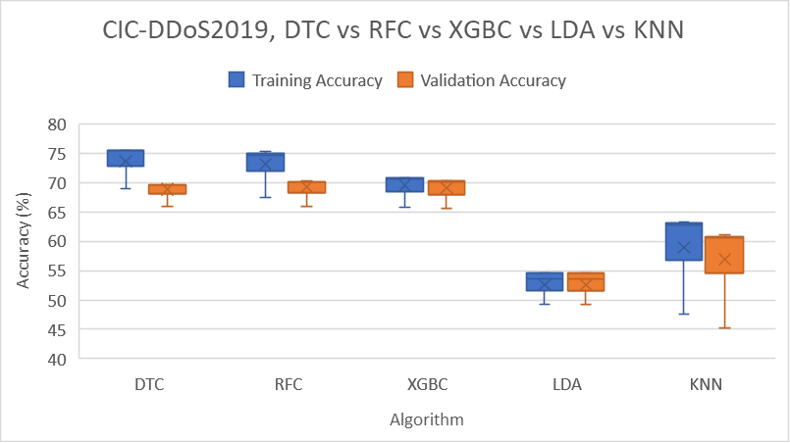
Validation accuracy ranking
XGBC (~70%)
RFC (~70%)
DTC (~70%)
KNN (55-60%)
LDA (50-55%)

Slide 26
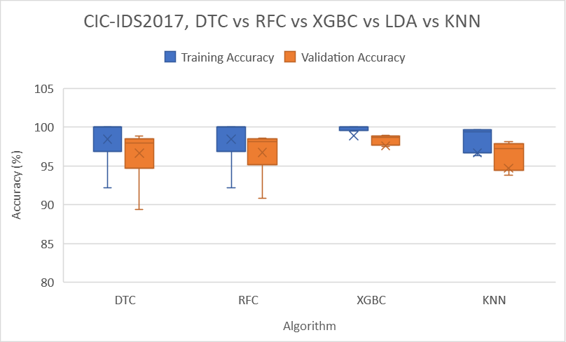
Validation accuracy ranking
XGBC (~98%)
RFC (~97%)
DTC (~97%)
KNN (~95%)

Slide 27
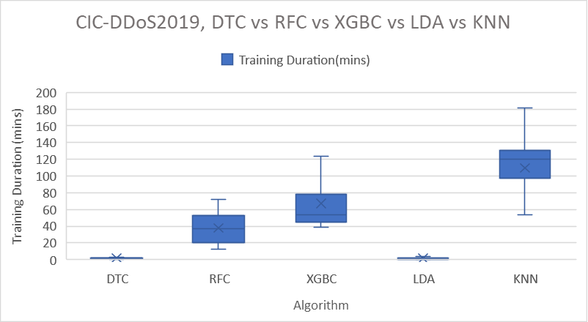
Training duration ranking
LDA ( < 1 mins)
DTC ( < 1 mins)
RFC (~ 40 mins)
XGBC ( ~ 70 mins)
KNN (~ 110 mins)

Slide 28
Pearson vs Spearman

Slide 29
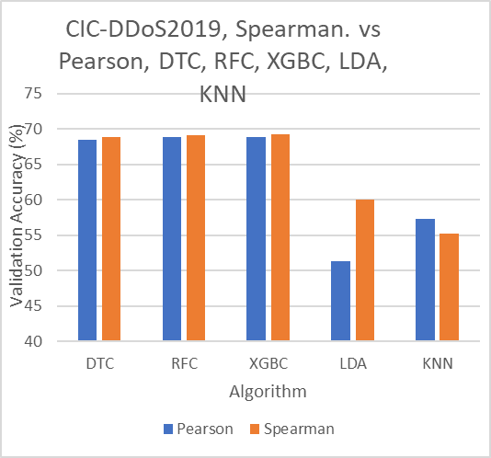
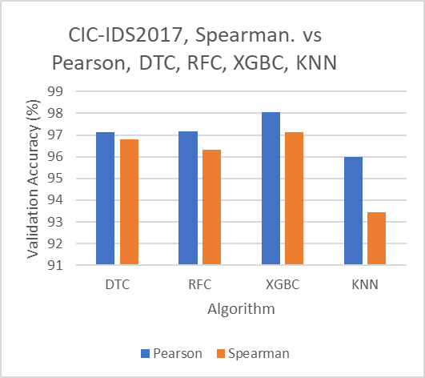
Only with KNN, Pearson identified correlations lead to better accuracies for both datasets

Slide 30
ANOVA vs Mutual Information

Slide 31
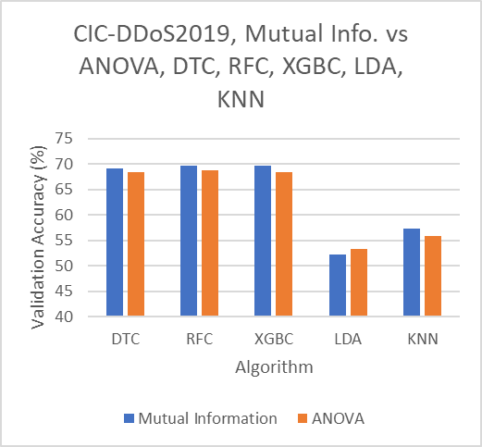
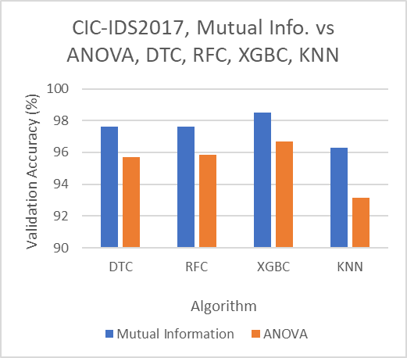
Mutual Information performed slightly better than ANOVA in all cases except from LDA

Slide 32
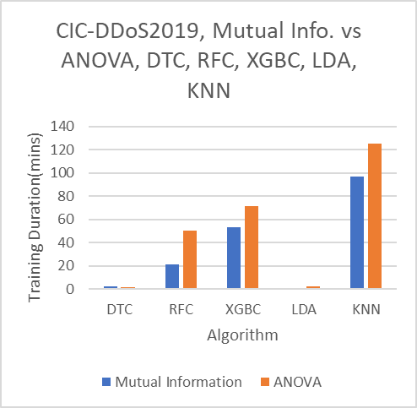
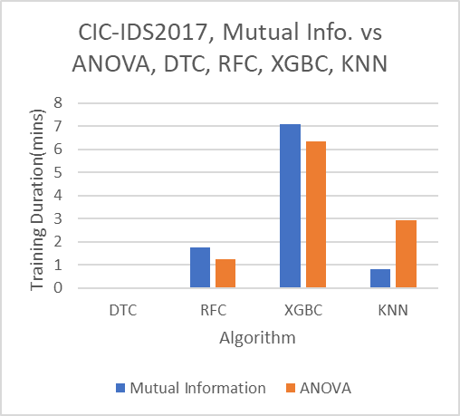
Mutual Information was significantly faster in the CIC-DDoS2019 dataset.

Slide 33
Hyperparameter Tuning
Reduced version of CIC-DDoS2019 dataset (10,000 samples/class)
5-Fold cross validation
Use of most accurate subset with shortest length
Algorithm | Combinations | Subset Length
DTC | 2160 | 10
RFC | 2880 | 15
XGBC | 864 | 20
KNN | 1650 | 15
LDA | 960 | 15

Slide 34
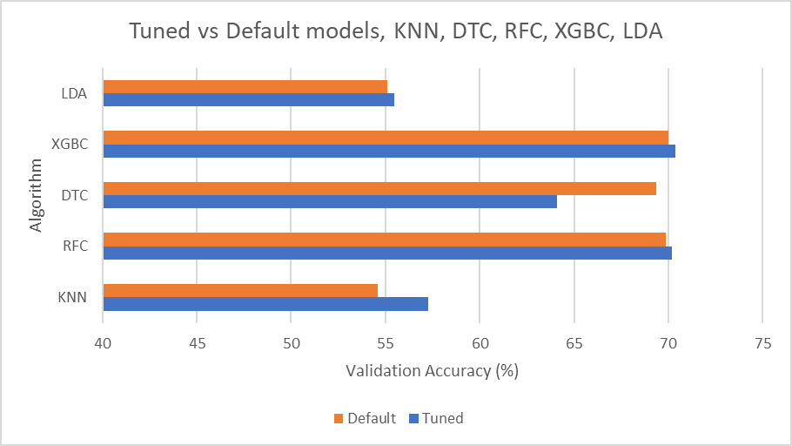
After tuning I retrained the algorithms with the best hyper-parameters found.
Surprisingly for DTC, the best hyperparameters identified for the reduced dataset are not the best for the normal version.

Slide 35
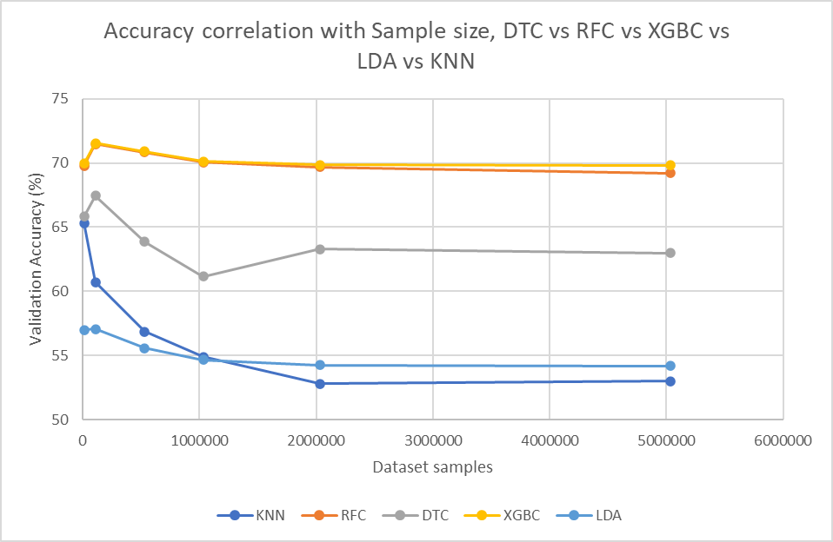
Accuracy drops as the dataset size increases due to overfitting. The accuracy stabilizes at about 2,000,000 sample size mark.
DTC didn’t perform well after tuning as it was supposed to be close to the other tree-based algorithms.

Slide 36
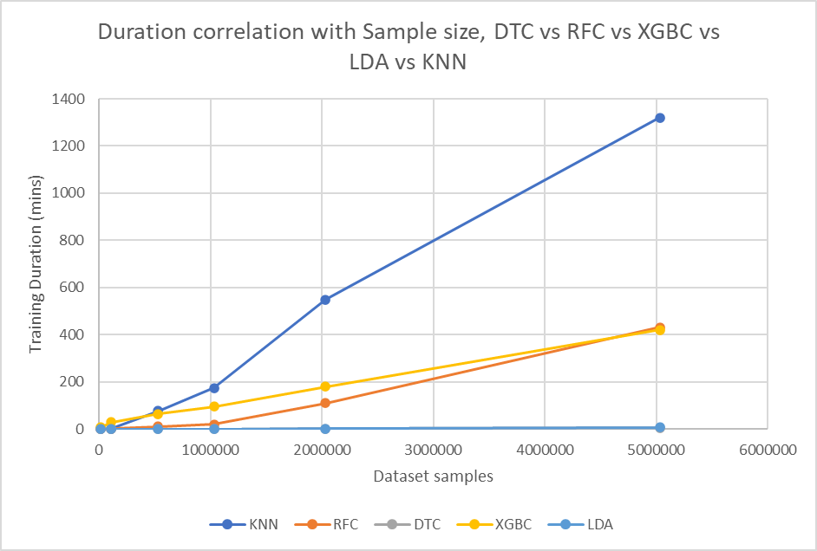
Training duration shows a linear increase with sample size

Slide 37
6. Conclusions

Slide 38
Machine Learning algorithms
Tree based algorithms were the most accurate with about 70% accuracy. These accuracies might not be realistic.
Simulation scenarios have fixed characteristics that the algorithms memorize and associate with the target classes => Overestimation, hard to generalize in different network setups.
The design of tree-based algorithms allow the association of the features’ values with the target => The problem of having biased features in the model that give away the target is more visible with these algorithms.

Slide 39
Machine Learning algorithms (Continued)
The best hyperparameters for reduced version of a dataset are not always the best for a different sample sizes. E.g. Decision tree classifier
The accuracy, drops when the sample size increases due to overfitting

Slide 40
Feature selection algorithms
Mutual Information performed slightly better than ANOVA
Mutual Info. can capture any kind of relationships with the target
Only 10 – 20 features were enough to produce the higher accuracies. More features were not helpful.

Slide 41
7. SYSTEM DESCRIPTION
Web application allowing users:
Upload their dataset on the server
Submit experiments on the server
Retrieve constant features
Retrieve correlated features
Retrieve K-Best features
Train ML-models and retrieve their performance
Tune ML-Models and retrieve their performance
Retrieve the results from the database

Slide 42
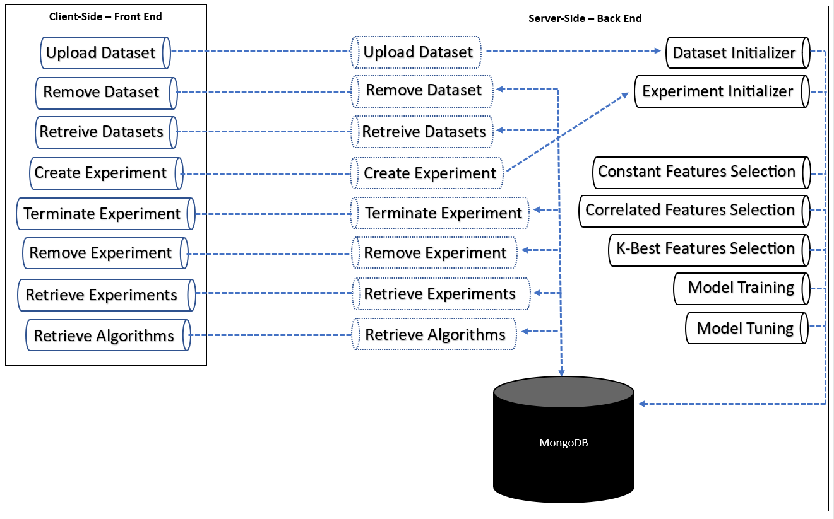
SYSTEM ARCHITECTURE
Front – End:
HTML
CSS
JAVASCRIPT
Back – End:
Apache Web Server
PHP
Python
Persistency:
MongoDB

Slide 43
8. Live Presentation

Slide 44
Thanks for your attention
10. Questions

Slide 45
Sources & Bibliography
Nazario, J. (2008). DDoS attack evolution. Network Security, 2008(7), 7-10.
Li, Y., & Liu, Q. (2021). A comprehensive review study of cyber-attacks and cyber security; Emerging trends and recent developments. Energy Reports, 7, 8176-8186.
Sharafaldin, I., Lashkari, A. H., Hakak, S., & Ghorbani, A. A. (2019, October). Developing realistic distributed denial of service (DDoS) attack dataset and taxonomy. In 2019 International Carnahan Conference on Security Technology (ICCST) (pp. 1-8). IEEE.
Iman Sharafaldin, Arash Habibi Lashkari, and Ali A. Ghorbani, “Toward Generating a New Intrusion Detection Dataset and Intrusion Traffic Characterization”, 4th International Conference on Information Systems Security and Privacy (ICISSP), Portugal, January 2018.
Dave, K. T. (2013). Brute-force attack ‘seeking but distressing’. Int. J. Innov. Eng. Technol. Brute-force, 2(3), 75-78.
Shorey, T., Subbaiah, D., Goyal, A., Sakxena, A., & Mishra, A. K. (2018, September). Performance comparison and analysis of slowloris, goldeneye and xerxes ddos attack tools. In 2018 International Conference on Advances in Computing, Communications and Informatics (ICACCI) (pp. 318-322). IEEE.
Sharma, A. DDOS AND HULK ATTACKS IN WEB APPLICATIONS WITH DETECTION MECHANISM
Khomutovskyy, S. (2021). Detection and mitigation of slow HTTP POST attack (Doctoral dissertation, Instytut Informatyki).
Lashkari, A. H., Zang, Y., Owhuo, G., Mamun, M. S. I., & Gil, G. D. (2017). CICFlowMeter. GitHub.[vid. 2021-08-10]. Dostupné z: https://github. com/ahlashkari/CICFlowMeter/blob/master/ReadMe. txt.
Segal, M. R. (2004). Machine learning benchmarks and random forest regression.
Chalyi, O., & Kolomytsev, M. (2022). Comparison of Tools for Web-Application Brute Forcing. Theoretical and Applied Cybersecurity, 4(1).
Otoum, Y., & Nayak, A. (2021). As-ids: Anomaly and signature based ids for the internet of things. Journal of Network and Systems Management, 29, 1-26.
Visoottiviseth, V., Sakarin, P., Thongwilai, J., & Choobanjong, T. (2020, November). Signature-based and behavior-based attack detection with machine learning for home IoT devices. In 2020 IEEE REGION 10 CONFERENCE (TENCON) (pp. 829-834). IEEE.
Ott, R. L., & Longnecker, M. T. (2015). An introduction to statistical methods and data analysis. Cengage Learning.
Shyr, J., & Spisic, D. (2014). Automated data analysis. Wiley Interdisciplinary Reviews: Computational Statistics, 6(5), 359-366.
Chen, Y., Pei, J., & Li, D. (2019, May). DETPro: a high-efficiency and low-latency system against DDoS attacks in SDN based on decision tree. In ICC 2019-2019 IEEE International Conference on Communications (ICC) (pp. 1-6). IEEE.
Chen, Y., Hou, J., Li, Q., & Long, H. (2020, December). DDoS attack detection based on random forest. In 2020 IEEE International Conference on Progress in Informatics and Computing (PIC) (pp. 328-334). IEEE.
Chen, Z., Jiang, F., Cheng, Y., Gu, X., Liu, W., & Peng, J. (2018, January). XGBoost classifier for DDoS attack detection and analysis in SDN-based cloud. In 2018 IEEE international conference on big data and smart computing (bigcomp) (pp. 251-256). IEEE.

Slide 46
Vu, N. H., Choi, Y., & Choi, M. (2008, April). DDoS attack detection using K-Nearest Neighbor classifier method. In Proceedings of the 4th IASTED International Conference on Telehealth/Assistive Technologies. Baltimore, Maryland, USA (pp. 248-253).
Thapngam, T., Yu, S., & Zhou, W. (2012, January). DDoS discrimination by linear discriminant analysis (LDA). In 2012 International Conference on Computing, Networking and Communications (ICNC) (pp. 532-536). IEEE.
Scikit-learn.org – Variance Threshold https://scikit-learn.org/stable/modules/generated/sklearn.feature_selection.VarianceThreshold.html
Pandas – pandas.DataFrame.corr https://pandas.pydata.org/docs/reference/api/pandas.DataFrame.corr.html
Cohen, I., Huang, Y., Chen, J., Benesty, J., Benesty, J., Chen, J., ... & Cohen, I. (2009). Pearson correlation coefficient. Noise reduction in speech processing, 1-4.
Myers, L., & Sirois, M. J. (2004). Spearman correlation coefficients, differences between. Encyclopedia of statistical sciences, 12.
Scikit-learn.org – SelectKBest https://scikit-learn.org/stable/modules/generated/sklearn.feature_selection.SelectKBest.html
Scikit-learn: Machine Learning in Python, Pedregosa et al., JMLR 12, pp. 2825-2830, 2011.
McKinney, W., & others. (2010). Data structures for statistical computing in python. In Proceedings of the 9th Python in Science Conference (Vol. 445, pp. 51–56).
Harris, C. R., Millman, K. J., Van Der Walt, S. J., Gommers, R., Virtanen, P., Cournapeau, D., ... & Oliphant, T. E. (2020). Array programming with NumPy. Nature, 585(7825), 357-362.
Breddels, M. A., & Veljanoski, J. (2018). Vaex: big data exploration in the era of gaia. Astronomy & Astrophysics, 618, A13.
Scikit-learn – cross_validation https://scikit-learn.org/stable/modules/cross_validation.html
Chen, T., & Guestrin, C. (2016). XGBoost: A Scalable Tree Boosting System. In Proceedings of the 22nd ACM SIGKDD International Conference on Knowledge Discovery and Data Mining (pp. 785–794). New York, NY, USA: ACM. https://doi.org/10.1145/2939672.2939785
PyMongo - https://pymongo.readthedocs.io/en/stable/
Hesterberg, T. (2011). Bootstrap. Wiley Interdisciplinary Reviews: Computational Statistics, 3(6), 497-526.
Lancaster, H. O., & Seneta, E. (2005). Chi‐square distribution. Encyclopedia of biostatistics, 2.
St, L., & Wold, S. (1989). Analysis of variance (ANOVA). Chemometrics and intelligent laboratory systems, 6(4), 259-272.
Kraskov, A., Stögbauer, H., & Grassberger, P. (2004). Estimating mutual information. Physical review E, 69(6), 066138.
GridSearchCV - https://scikit-learn.org/stable/modules/generated/sklearn.model_selection.GridSearchCV.html
DataRobot https://www.datarobot.com/platform/
Rosay, A., Cheval, E., Carlier, F., & Leroux, P. (2022, February). Network intrusion detection: A comprehensive analysis of CIC-IDS2017. In 8th International Conference on Information Systems Security and Privacy (pp. 25-36). SCITEPRESS-Science and Technology Publications.
Chadd, A. (2018). DDoS attacks: past, present and future. Network Security, 2018(7), 13-15.
CloudFare - Famous DDoS attacks | The largest DDoS attacks of all time https://www.cloudflare.com/learning/ddos/famous-ddos-attacks/
RapidMiner - https://rapidminer.com/

